Slide 1
Programming Fundamentals Lecture #4 Overview of Computer Programming
Junaid Hassan
Lecturer CS & IT Department UOS MBDIN
junaidte14@gmail.com

Slide 2
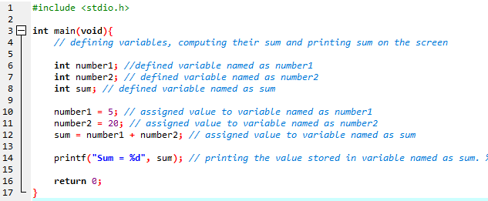
C Program (Defining Variables and Sum)
Define 2 variables, sum their values and print sum on the screen

Slide 3
C Program (Defining Variables and Sum)
In line printf(“Sum is %d”, sum); %d is called as conversion specifier.
%d indicates that the data should be an integer. The letter d stands for decimal integer.
This placeholder is ultimately filled by the value of variable named as ‘sum’.

Slide 4
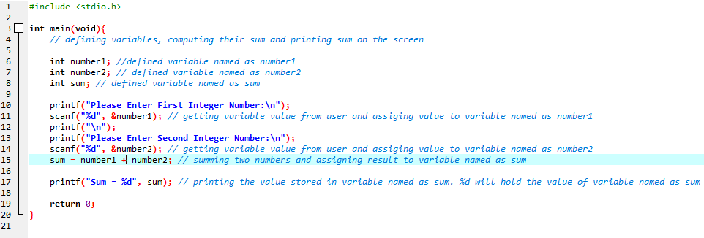
C Program (Taking Input From User)
Take 2 input integer numbers from user, sum these number and print the result on the screen

Slide 5
C Program (Taking Input From User)
Everything in this program is explained in previous slides except following line:
scanf("%d", &number1);
We already discussed that %d is a conversion specifier which says that it will hold data of the type decimal integer
Whereas ampersand (&) is called as address operator in C.
Ampersand (&) when combined with variable name (number1), tells scanf the location (or address) in memory at which the variable number1 is stored
Use of ampersand will become clear when we will study pointers in chapter 7

Slide 6
Memory Concepts
Variables we defined in our previous code examples actually correspond to locations in the computer memory
Every variable has a name, type and value
For example when scanf(“%d”, &number1); is executed, the value entered by the user is stored into a memory location and we have assigned a name to that location i.e number1.
Similarly value of each variable is stored into a different memory location and when we need to get the value stored at that memory location, we use the variable name
When we assign new value to a variable then previous value is replaced by that new value.
In other words previous value stored at that memory location is destroyed and is replaced by the new value

Slide 7
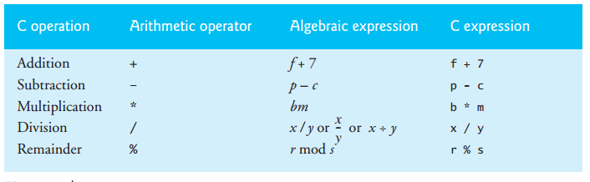
Arithmatic in C
C programs can perform arithmatic operations using following symbols:

Slide 8
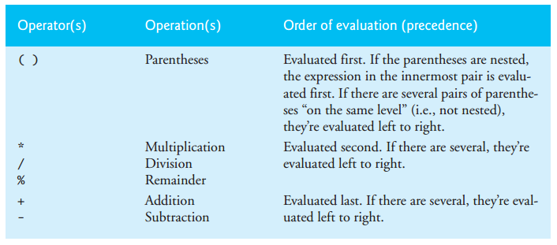
Arithmatic in C
Precedence of arithmatic operators:

Slide 9
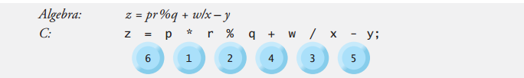
Arithmatic in C
Example of precedence of arithmatic operators:

Slide 10
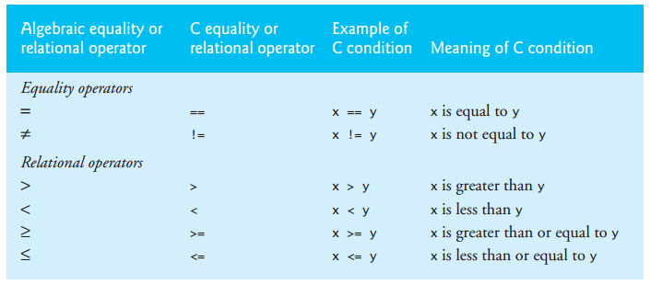
Decision Making: Equality and Relational Operators
In C Program, sometime we need to make decisions by comparing variable values. In order to make decisions in C programming, we use equality and relational operators.
If Statment is used to make a decision whether a condition is true or false
Conditions in if statement are formed using equality and relational operators (shown in below table)

Slide 11
Decision Making: Equality and Relational Operators
See Example Code

Slide 12
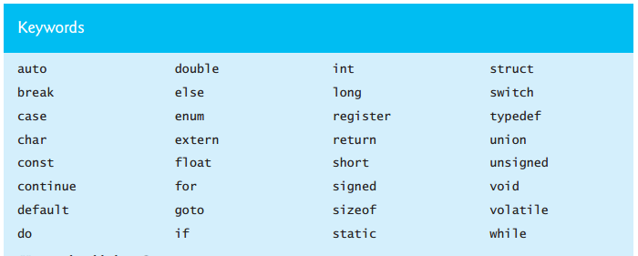
Keywords / Reserved Words in C
Keywords / reserved words have special meaning to compiler, so don’t use these keywords as your variable names in order to avoid conflicts/fatal errors. Keywords/reserved words used in C are mentioned in below table:

